Slide 1

SPARK

Slide 2
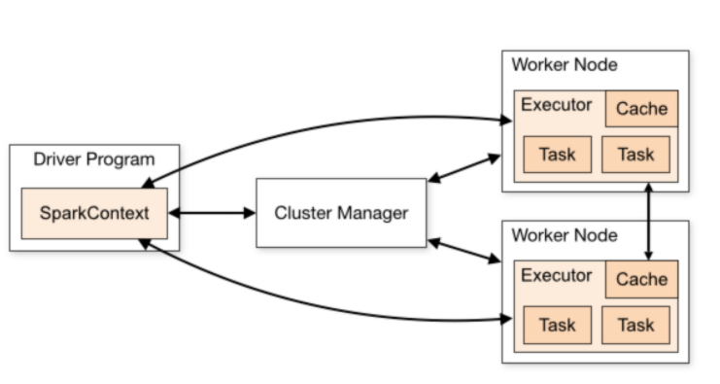
Contents
Apache Cluster Manager
Running Spark job on EMR
Driver Class Configuration
Executors

Slide 3
Apache Cluster Manager
Apache Spark is an engine for Big Data processing.
One can run Spark on distributed mode on the cluster.
In the cluster, there is a master and n number of workers.
It schedules and divides resource in the host machine which forms the cluster.

Slide 4
The prime work of the cluster manager is to divide resources across applications.
It works as an external service for acquiring resources on the cluster.
The cluster manager dispatches work for the cluster. Spark supports pluggable cluster management.
The cluster manager in Spark handles starting executor processes.

Slide 5
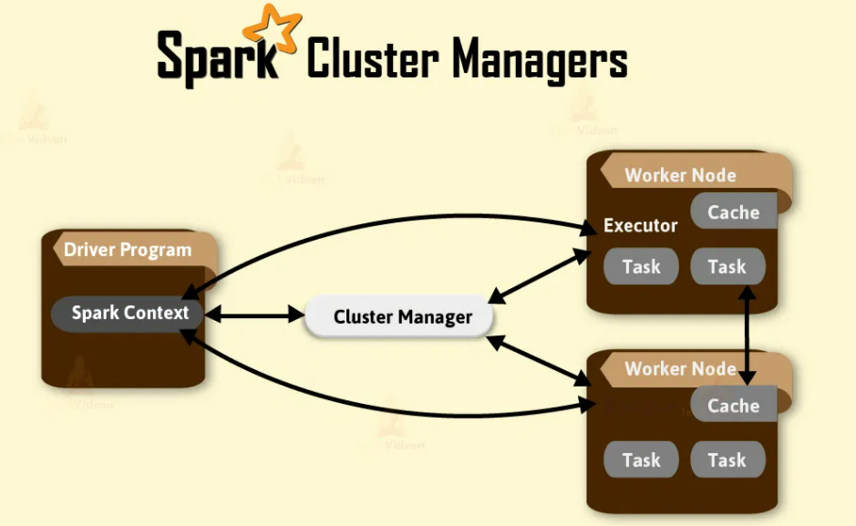
Apache Spark system supports three types of cluster managers namely-
1. Standalone Cluster Manager
2. Apache Mesos
3. Hadoop YARN

Slide 6
1. Apache Spark Standalone Cluster Manager
Standalone mode is a simple cluster manager incorporated with Spark.
It makes it easy to setup a cluster that Spark itself manages and can run on Linux, Windows, or Mac OSX.
Often it is the simplest way to run Spark application in a clustered environment

Slide 7
a. How does Spark Standalone Cluster Works?
It has masters and number of workers with configured amount of memory and CPU cores.
In Spark standalone cluster mode, Spark allocates resources based on the core. By default, an application will grab all the cores in the cluster.
In standalone cluster manager, Zookeeper quorum recovers the master using standby master. Using the file system, we can achieve the manual recovery of the master.
Spark supports authentication with the help of shared secret with entire cluster manager.

Slide 8
The user configures each node with a shared secret. For communication protocols, Data encrypts using SSL. But for block transfer, it makes use of data SASL encryption.
To check the application, each Apache Spark application has a Web User Interface.
The Web UI provides information of executors, storage usage, running task in the application. In this cluster manager, we have Web UI to view cluster and job statistics. It also has detailed log output for each job.
If an application has logged event for its lifetime, Spark Web UI will reconstruct the application’s UI after the application exits.

Slide 9
2. Apache Mesos
Mesos handles the workload in distributed environment by dynamic resource sharing and isolation.
It is healthful for deployment and management of applications in large-scale cluster environments.
Apache Mesos clubs together the existing resource of the machines/nodes in a cluster.
From this, a variety of workloads may use. This is node abstraction, thus it decreases an overhead of allocating a specific machine for different workloads. It is resource management platform for Hadoop and Big Data cluster.

Slide 10
Companies such as Twitter, Xogito, and Airbnb use Apache Mesos as it can run on Linux or Mac OSX.
In some way, Apache Mesos is the reverse of virtualization.
This is because in virtualization one physical resource divides into many virtual resources.
While in Mesos many physical resources are club into a single virtual resource.

Slide 11
a. How do Apache Mesos works?
The three components of Apache Mesos are Mesos masters, Mesos slave, Frameworks.
Mesos Master is an instance of the cluster.
A cluster has many Mesos masters that provide fault tolerance. Here one instance is the leading master.
Mesos Slave is Mesos instance that offers resources to the cluster. Mesos Master assigns the task to the slave. Mesos Framework allows applications to request the resources from the cluster. Thus, the application can perform the task.

Slide 12
Some other Frameworks by Mesos are Chronos, Marathon, Aurora, Hadoop, Spark, Jenkins etc.
Mesos authentication includes:
The slave’s registration with the master.
Frameworks (that is, applications) submission to the cluster.
Operators using endpoints such as HTTP endpoints.

Slide 13
3. Hadoop YARN
YARN became the sub-project of Hadoop in the year 2012.
It is also known as MapReduce 2.0.
YARN bifurcate the functionality of resource manager and job scheduling into different daemons.
The plan is to get a Global Resource Manager (RM) and per-application Application Master (AM). An application is either a DAG of graph or an individual job.

Slide 14
a. How do Hadoop YARN works?
YARN data computation framework is a combination of the ResourceManager, the NodeManager. It can run on Linux and Windows.
The Yarn Resource Manager manages resources among all the applications in the system.
The Resource Manager has scheduler and Application Manager. The Scheduler allocates resource to the various running application.
It is pure Scheduler, performs monitoring or tracking of status for the application. The Application Manager manages applications across all the nodes.

Slide 15
Yarn Node Manager contains Application Master and container. A container is a place where a unit of work happens. Each task of MapReduce runs in one container.
The application or job requires one or more containers. Node Manager handles monitoring containers, resource usage (CPU, memory, disk, and network). It reports this to the Resource Manager.
YARN provides security for authentication, service level authorization.
It also provides authentication for Web consoles and data confidentiality. Hadoop authentication uses Kerberos to verify that each user and service has authentication.

Slide 16
Spark Standalone mode vs YARN vs Mesos
i. High Availability
The standalone cluster: with ZooKeeper Quorum it supports an automatic recovery of the master. One can achieve manual recovery using the file system. The cluster tolerates the worker failure despite the recovery of the Master is enabling or not.
The Apache Mesos: using Apache ZooKeeper it supports an automatic recovery of the master. In the case of failover, tasks which are currently executing, do not stop their execution.
Apache Hadoop YARN: using a command line utility it supports manual recovery. And use Zookeeper-based ActiveStandbyElector embedded in the ResourceManager for automatic recovery. Thus, there is no need to run a separate ZooKeeper Failover Controller.

Slide 17
ii. Security
Spark supports authentication via a shared secret with all the cluster managers. The standalone manager requires the user to configure each of the nodes with the shared secret. Data can be encrypted using SSL for the communication protocols. SASL encryption is supported for block transfers of data. Other options are also available for encrypting data. Access to Spark applications in the Web UI can be controlled via access control lists.
Mesos: For any entity interacting with the cluster Mesos provides authentication. This includes the slaves registering with the master, frameworks submitted to the cluster, and operators using endpoints such as HTTP endpoints. These entities can be enabling to use authentication or not. Custom module can replace Mesos’ default authentication module, Cyrus SASL.

Slide 18
Hadoop YARN: It contains security for authentication, service level authorization, authentication for Web consoles and data confidentiality. Using Service level authorization it ensures that client using Hadoop services has authority. Using access control lists Hadoop services can be controlled. Additionally, using SSL data and communication between clients and services is encrypted. The data transferred between the Web console and clients with HTTPS.

Slide 19
iii. Monitoring
Spark’s standalone cluster manager: To view cluster and job statistics it has a Web UI. It also has detailed log output for each job. the Spark Web UI will reconstruct the application’s UI after the application exists if an application has logged events for its lifetime.
Apache Mesos: It supports per container network monitoring and isolation. It provides many metrics for master and slave nodes accessible with URL. These metrics include percentage and number of allocated CPU’s, memory usage etc.
Hadoop YARN has a Web UI for the ResourceManager and the NodeManager. The ResourceManager UI provides metrics for the cluster. And the NodeManager provides information for each node, the applications and containers running on the node.

Slide 20
Standalone mode is easy to set up among all. It will provide almost all the same features as the other cluster managers.
Moreover, to use richer resource scheduling capabilities (e.g. queues), both YARN and Mesos provide these features. Of these, YARN allows you to share and configure the same pool of cluster resources between all frameworks that run on YARN. It is likely to be pre-installed on Hadoop systems.
Also, one advantage of Mesos over both YARN and the standalone mode is its fine-grained sharing option. Now, this lets interactive applications (Spark shell) scale down their CPU allocation between commands. This makes it attractive in environments where many users are running interactive shells.

Slide 21
Running Spark job on EMR
AWS and Amazon EMR
AWS is one of the most used cloud services platform, a lot of services are available, it is very well documented and easy to use.
A cloud services platform allow users to access on-demand resources (compute power, memory, storage) and services (databases, monitoring, workflow, etc.) via the internet with pay-as-you-go pricing.

Slide 22
Among all the cool services offered by AWS, we will only use two of them :
Simple Storage Service (S3), a massively scalable object storage service
Elastic MapReduce (EMR), a managed cluster platform that simplifies running big data frameworks, such as Apache Hadoop and Apache Spark. It can be view like Hadoop-as-a-Service, you start a cluster with the number of nodes you want, run any job you want and only pay for the time the cluster is actually up.

Slide 23
The aim of this tutorial is to launch the classic word count Spark Job on EMR. The input and output files will be store using S3 storage.
All steps are simples and I will explain how to do it using both AWS UIs and the AWS CLI tool.
Here is the word count Spark code (using Spark 2.2.0) which will be used :

Slide 24
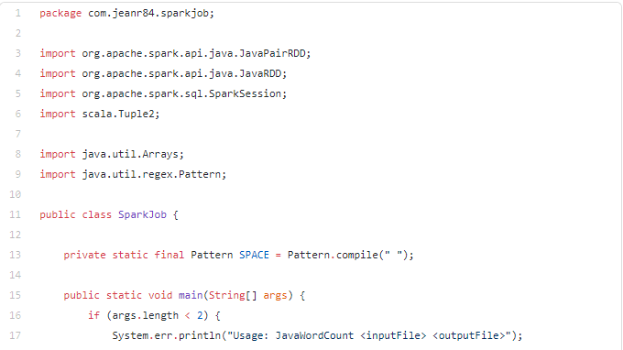

Slide 25
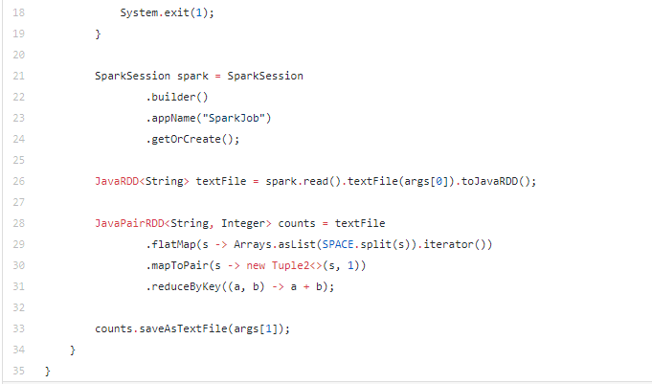

Slide 26
Create an AWS account
First of all, create a free trial AWS account on AWS website. The form is simple and quick to fill, you will need to enter your credit card information which will be used for Amazon EMR pricing and for other services if you use more than the free trial account quotas.
For those who want to use AWS CLI
If you don’t want to waste time doing the different steps using Amazon Graphic User Interfaces and want to automate it, you can install AWS CLI using this documentation.

Slide 27
Choose a region on which deploy the cluster
Depending on the date you signed up for an AWS account, the default region when you access a resource from the AWS Management Console is different.
Each region have his own type of resources and pricing. The aim of this tutorial is to present how to run a Spark job, we don’t really care about performances.
You can change the region by clicking at the up-right corner on each of the different AWS Management console.

Slide 28
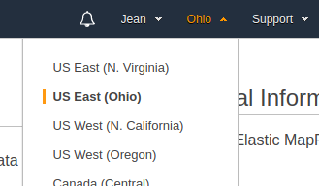
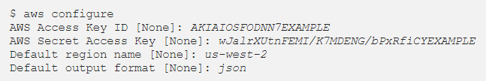
Using AWS CLI aws configure you can specify the default region among this list of regions.

Slide 29
Create an Amazon S3 Bucket
In this use case, we will use Amazon S3 bucket to store our Spark application jar, logs, input and output files.
1. Open the Amazon S3 console
2. Choose Create bucket
3. Type a name for your bucket (ex : my-first-emr-bucket) and choose its AWS Region then click next.

Slide 30
4. On the Set properties page, you can configure some properties for the bucket. In this tutorial we don’t need any specific properties, click next.
5. On the Set permissions page, you manage permissions that are set on the bucket that you are creating. We will use the default permissions, click next.
6. On the Review page, verify the settings and choose Create bucket.

Slide 31

Using AWS CLI aws s3api create-bucket

Slide 32
Upload files on Amazon S3
Now that our S3 bucket is created, we will upload the Spark application jar and an input file on which we will apply the wordcount.
1. On the Amazon S3 console click on the bucket you just created
2. Choose Create folder, enter the name of the folder (ex : tutorialEMR), the encryption setting (ex : None) and save
3. Click on the folder you just created, then choose upload to upload the Spark application jar and the input text file on which you want to apply the wordcount

Slide 33
Using AWS CLI, use aws s3 sync to upload the directory containing the Spark application jar and the input text file

Slide 34
Create an Amazon EMR cluster & Submit the Spark Job
In this step, we will launch a sample cluster running the Spark job and terminating automatically after the execution.
Open the Amazon EMR console
On the right left corner, change the region on which you want to deploy the cluster
Choose Create cluster

Slide 35
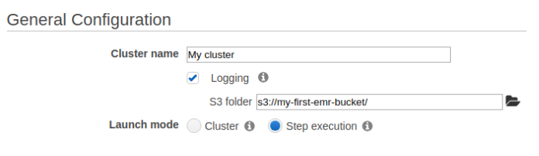
4. On the General Configuration section, enter the cluster name, choose the S3 bucket you created (the logs will be stored in this bucket) and check Step execution.
5. On the Add steps section, select Spark application, click Configure and fill the popup like this:

Slide 36
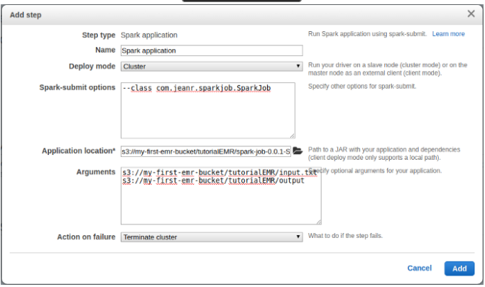

Slide 37
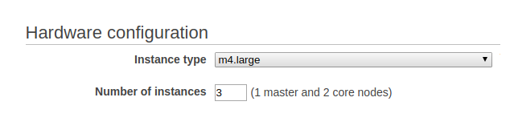
6. On the Software Configuration section, use the default release (the last one)
7. On the Hardware configuration section, choose the instance type and the number of instances
8. On the Security and access section, use the Default values.

Slide 38
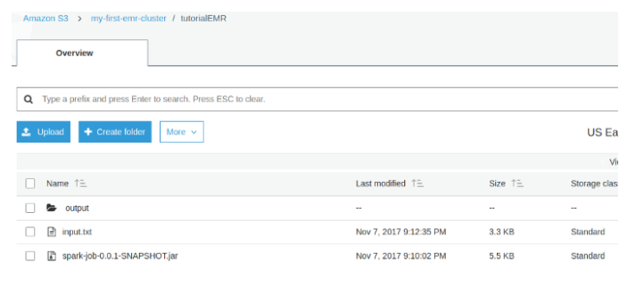
9. Click on Create cluster
10. Click on the refresh icon to see the status passing from Starting to Running to Terminating — All steps completed
11. Now go back to the S3 console and you will see the output directory in which the result has been stored, you can click on it and download its contents

Slide 39


Using AWS CLI
1. Create default roles which will be used to create the cluster
2. Find the SubnetId of our default region

Slide 40
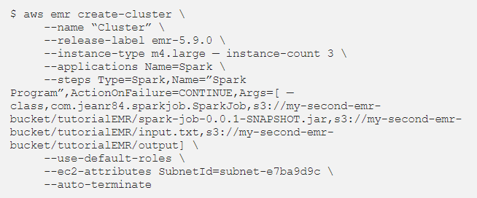
3. Create the cluster and submit the Spark step

Slide 41
4. Download locally the result repository

Slide 42
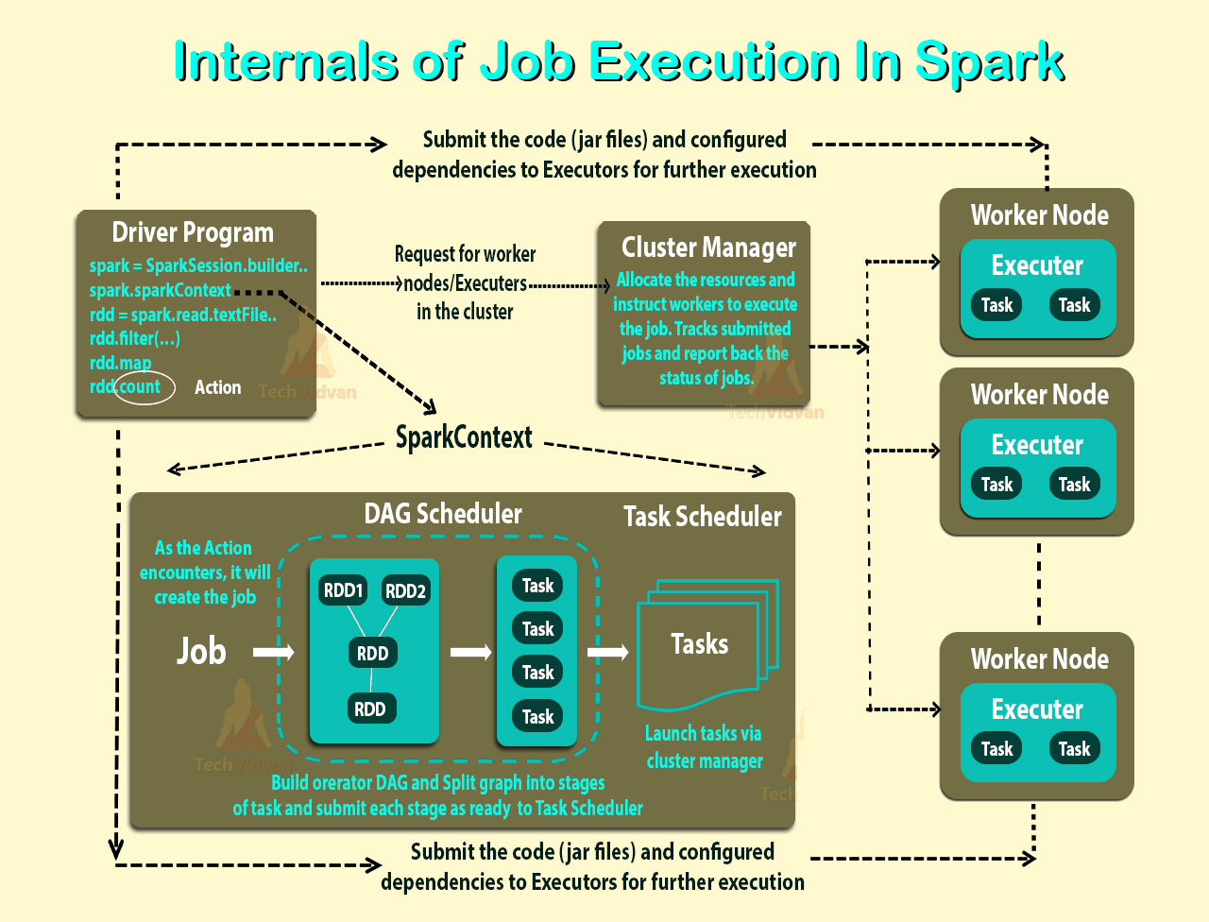

Slide 43
Driver
Driver is a Java process. This is the process where the main() method of our Scala, Java, Python program runs.
It executes the user code and creates a SparkSession or SparkContext and the SparkSession is responsible to create DataFrame, DataSet, RDD, execute SQL, perform Transformation & Action, etc.

Slide 44
Responsibility of DRIVER
The main() method of our program runs in the Driver process. It creates SparkSession or SparkContext.
Conversion of the user code into Task (transformation and action). It looks at the user code and determines are the possible Tasks, i.e. the number of tasks to be performed is decided by the Driver.
Helps to create the Lineage, Logical Plan and Physical Plan.

Slide 45
Once the Physical Plan is generated, the Driver schedules the execution of the tasks by coordinating with the Cluster Manager.
Coordinates with all the Executors for the execution of Tasks. It looks at the current set of Executors and schedules our tasks.
Keeps track of the data (in the form of metadata) which was cached (persisted) in Executor’s (worker’s) memory.

Slide 46
Executor
Executor resides in the Worker node.
Executors are launched at the start of a Spark Application in coordination with the Cluster Manager.
They are dynamically launched and removed by the Driver as per required.

Slide 47
Conditions to Create Spark Executor
Some conditions in which we create Executor in Spark is:
When CoarseGrainedExecutorBackend receives RegisteredExecutor message. Only for Spark Standalone and YARN.
While Mesos’s MesosExecutorBackend registered on Spark.
When LocalEndpoint is created for local mode.

Slide 48
Creating Spark Executor Instance
By using the following, we can create the Spark Executor:
From Executor ID.
By using SparkEnv we can access the local MetricsSystem as well as BlockManager. Moreover, we can also access the local serializer by it.
From Executor’s hostname.
To add to tasks’ classpath, a collection of user-defined JARs. By default, it is empty.
By flag whether it runs in local or cluster mode (disabled by default, i.e. cluster is preferred)

Slide 49
Responsibility of EXECUTOR
To run an individual Task and return the result to the Driver.
It can cache (persist) the data in the Worker node.

Slide 50
END OF SESSION
Q&A

